Slide 1
They Hunger from the satellites
Introducing…

Slide 2
Drew jensen
Data Dictionary Visionary a.k.a The Mad Columnist

Slide 3
Muhammad Bilal
ERD Designer a.k.a. The Relationship Expert

Slide 4
Caleb halvorson
Database Engineer a.k.a The Cog of Creation

Slide 5
Joshua tiemens
Communicator
a.k.a. The Deranged Storyteller

Slide 6
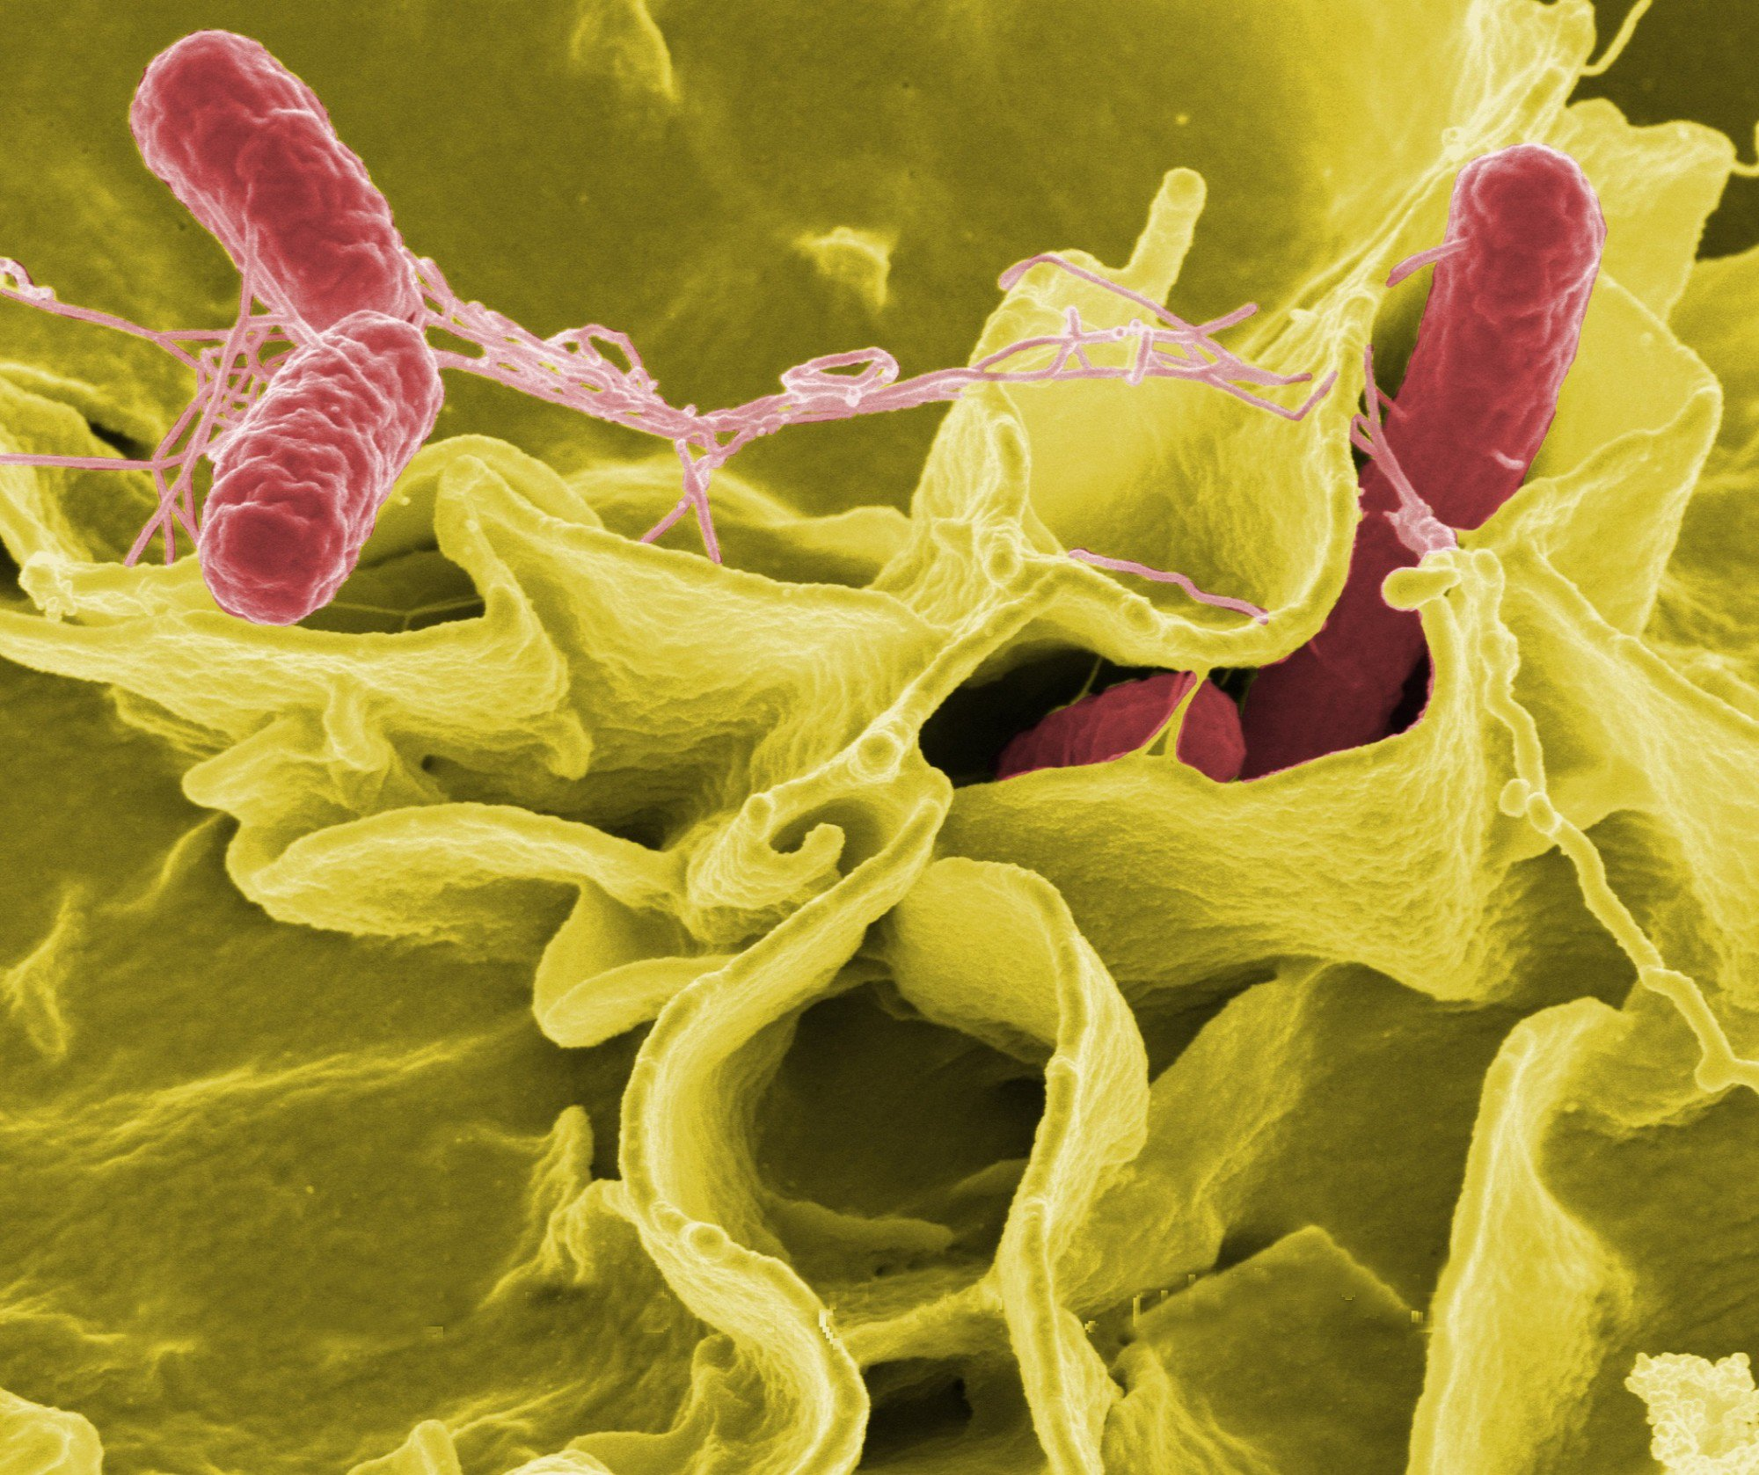
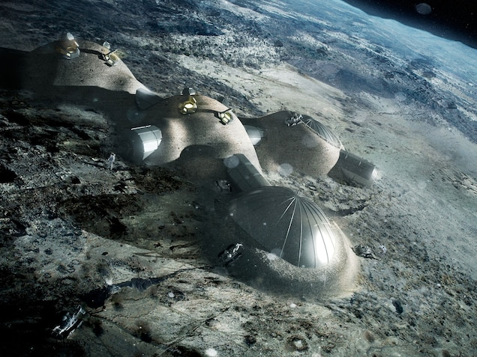
Events thus transpired
Venture to the dark side has proven dangerous
A foreign enemy we named The Demshi destroyed our technologies and data
Transportation to Earth was destroyed
Problematic disease turning humans into mindless, aggressive threats
Resources are compromised

Slide 7

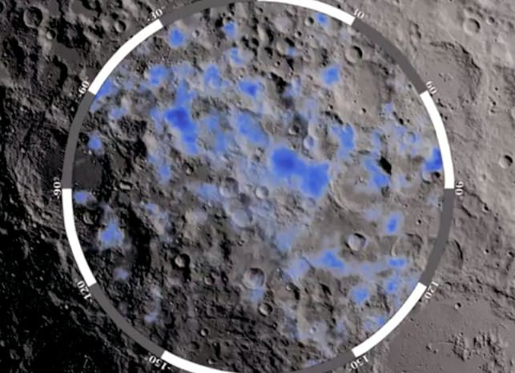
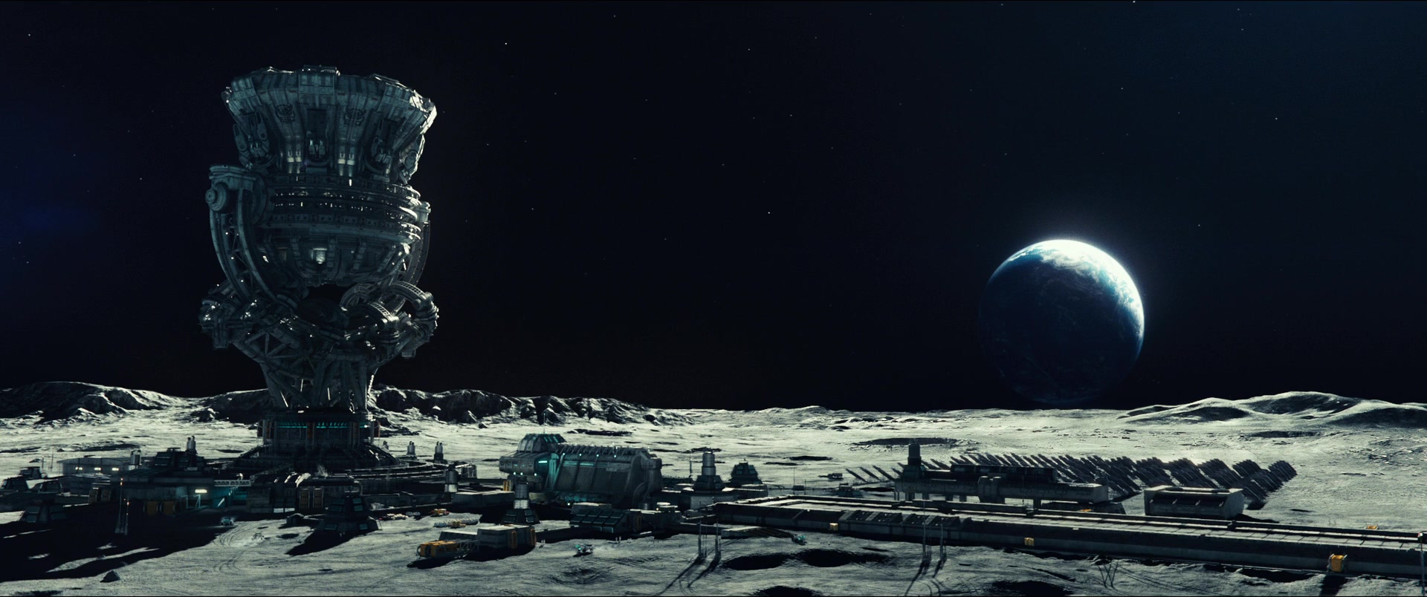
Our control on data (drew)
Our data originally tracked resources of production
Our goods had a consistent transfer rate
Productivity reports proved resource promise

Slide 8
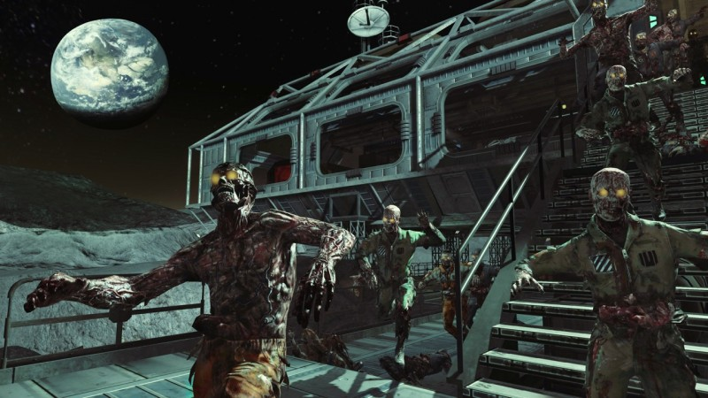
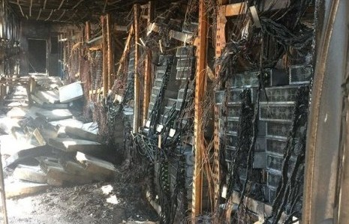

Our disaster (drew)
Majority of our systems have suffered great damage
Infected rate continues to grow, and vaccine studies haven’t progressed
Main mission is still a priority
Trade routes have reduced
Bases are being sieged by the infected

Slide 9
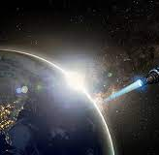
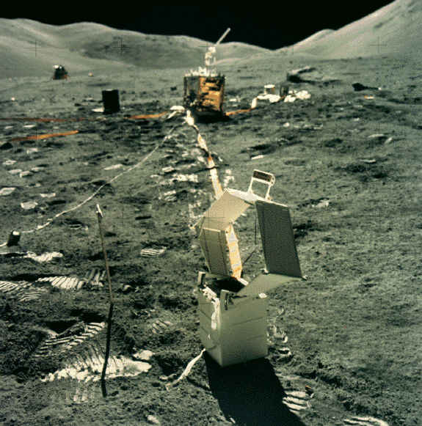
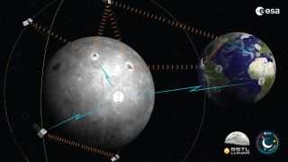
Our focus (drew)
Tracking infected and their attributes
Tracking resources
Tracking Miners, Growers, Scientists, and Military
Tracking base operations and hostile locations
Tracking colonists and skills
Population control

